Slide 1
Final Project : Cloud Computing ECE 9016
Cloud
Saeid Abedi: sabedi4@uwo.ca
Stephan Dhanraj: sdhanraj@uwo.ca
James Zhong: pzhong22@uwo.ca
Reza Motazed Monadjemi: rmotazed@uwo.ca
James Suresh: jsuresh3@uwo.ca
Group 07
Computing

Slide 2

Introduction
The project focuses on a simple web application. This application interacts with a deployed database container. The report covers container development and deployment processes. Deployment is to a Kubernetes cluster. Environments covered include both development and production settings.
Intro

Slide 3


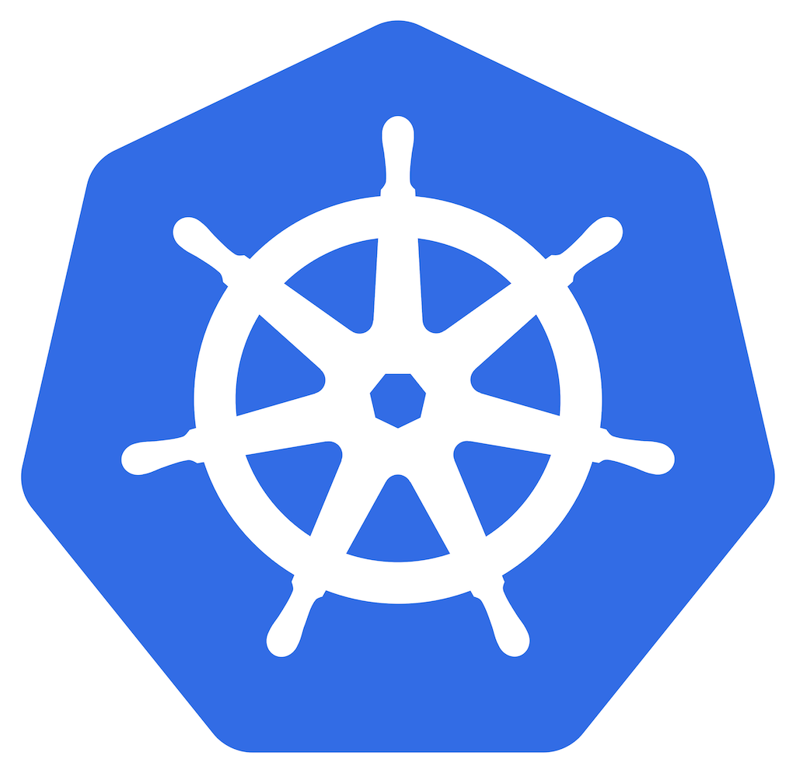
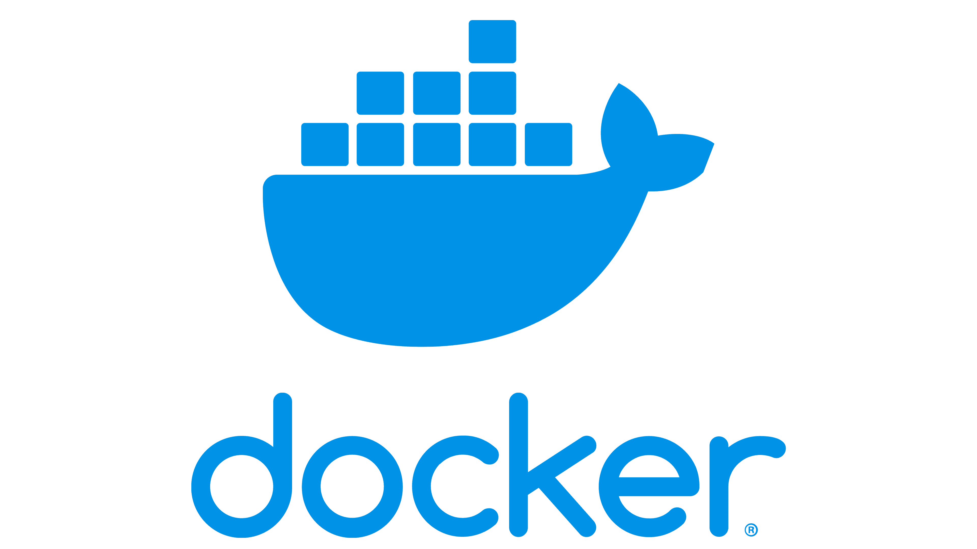

Technologies Used
01
02
03
04
05
Google Cloud
Kubernetes (GKE)
Docker
Node.js
MongoDB

Slide 4

Containerized Application
Our application is structured around two main containers:
a back-end MongoDB container for data storage
a front-end Node.js container responsible for serving HTML and making database calls.
Cloud Computing

Slide 5
Back-end Container
Cloud
Uses standard MongoDB image from DockerHub for consistency.
Requires a locally mounted volume for data storage.
Data accessibility ensured through mounted volume.
YAML configuration files detail the volume mounting process.

Slide 6
Front-end Container
Computing
Containers handle HTML serving and database requests.
Utilizes Next.js server due to its MongoDB driver support.
Installation of new dependencies, including Next and MongoClient, required.
Front-end container built on the standard Node.js image.

Slide 7
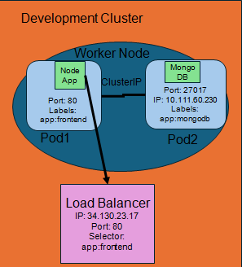
Development Environment

Slide 8
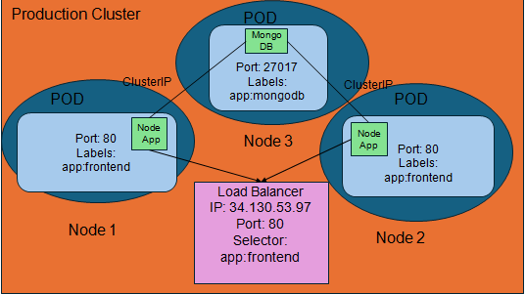
Production Environment

Slide 9
Deployment steps of Dev and Prod Env
Deploy the cluster
Mount the PVC using the PVC yaml file
Deploy the mongodb database pod
Create the mongodb clusterIP service
Give the docker image the IP of the cluster via the clusterIP
Build the new frontend container with the IP
Tag and push the new container image
Deploy the front-end pod
Deploy the front-end load balancer
The difference in the deployment is in the frontend of the production yaml file.

Slide 10
gcloud container clusters create dev-cluster-realestate --num-nodes 1 --machine-type e2-standard-4
Kubectl apply –f mongodb-pvc.yaml
Kubectl apply –f db-deployment.yaml
Kubectl apply –f mongodb service_ClusterIP.yaml
docker build -t northamerica-northeast2-docker.pkg.dev/real-estate-group-416222/docker-rep3/frontend:latest .
docker push northamerica-northeast2-docker.pkg.dev/real-estate-group-416222/docker-rep3/frontend:latest
kubectl apply -f frontend-deployment.yaml
kubectl apply -f frontend-service.yaml

Slide 11
YAML Descriptions
Cloud
Database Deployment Manifest:
Describes a Kubernetes YAML file for MongoDB setup named 'ece9016-mongodb'.
Deployment utilizes one instance with the 'mongodb' label.
Details include a MongoDB container on its standard port, secured with username and password.
Connects to a persistent storage volume for data integrity across restarts.
Volume Mounting Manifest
Requests Kubernetes to reserve persistent storage space via a PVC named 'ece-9016-pvc'.
Ensures consistent data storage/retrieval, even with container changes.
PVC seeks 10GB of 'ReadWriteOnce' storage, allowing single-pod read/write access.
Specifies 'standard' storage class, common in Kubernetes, for reliable data maintenance.
Computing

Slide 12

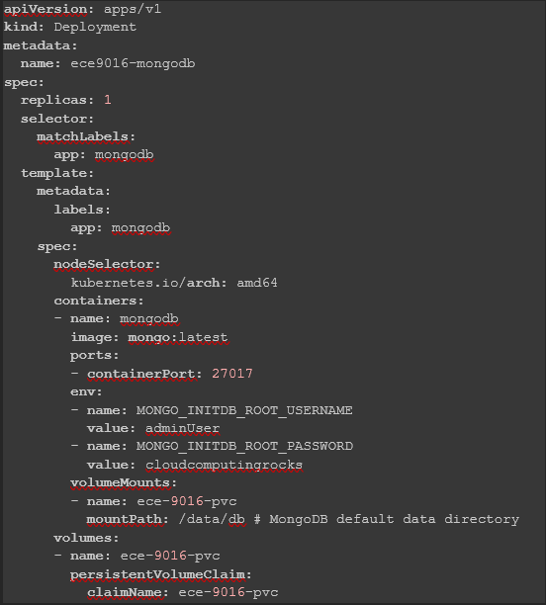
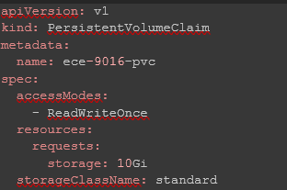
Database Deployment Manifest
Volume Mounting Manifest

Slide 13
YAML Descriptions
Cloud
Database ClusterIP service Manifest:
Configures a Kubernetes network service 'mongodb-service' for MongoDB communication.
Service lacks an external IP but is internally accessible within the cluster.
Listens on MongoDB's standard port 27017, routing traffic to the matching pod.
Uses 'app: mongodb' label to identify and direct traffic to the correct MongoDB pod.
Development Environment Frontend Deployment Manifest:
Outlines Kubernetes config for a single-instance 'frontend' container service.
Utilizes 'replicas: 1' for a solitary front-end instance in development.
Labels deployment and pods as 'app: frontend' for simplified Kubernetes management.
Configures to use a specific, latest Docker image from a repository for the front-end.
Sets the container to listen on port 80 for HTTP traffic, ensuring web accessibility.
Employs 'hostPort' to align container's port 80 with the host's, enabling direct host access.
Designed to facilitate easy testing and development with the most updated front-end version.
Computing

Slide 14
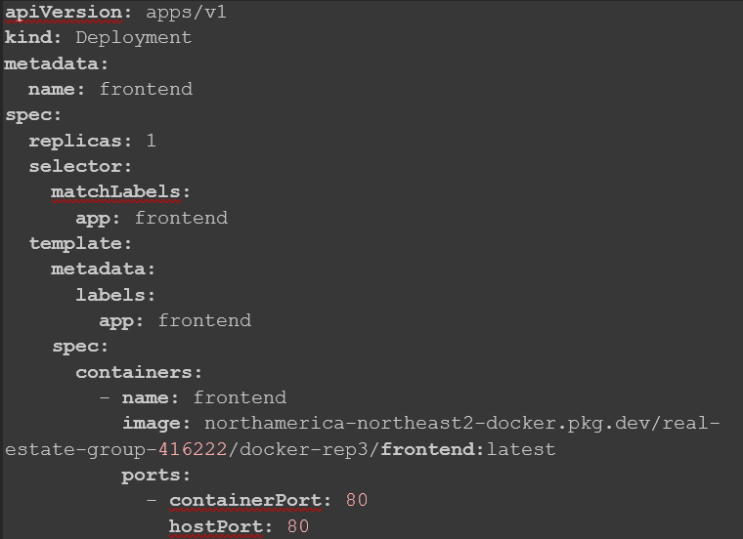
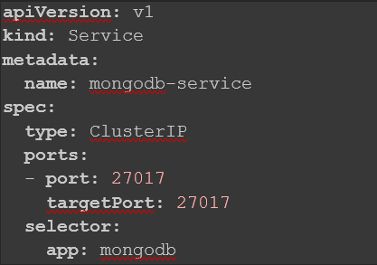
Development Environment Frontend Deployment Manifest:
Database ClusterIP service Manifest

Slide 15
YAML Descriptions
Cloud
Frontend Load Balancer Manifest
Configures 'frontend-service' as a Kubernetes LoadBalancer to distribute web traffic.
Enables external traffic reception on port 80, directing it to front-end containers.
Searches for pods labeled 'app: frontend' for traffic distribution.
Aims for efficient traffic management and enhanced application availability.
Production Environment Frontend Manifest
Sets up two instances of the front-end in the production environment for better availability.
Uses 'frontend' as the deployment name with the latest Docker image for consistency.
Configures each front-end instance to operate on port 80 for standard web traffic handling.
Employs 'affinity' settings, specifically 'podAntiAffinity', to distribute instances across different physical machines, enhancing reliability and failure resilience.
Computing

Slide 16
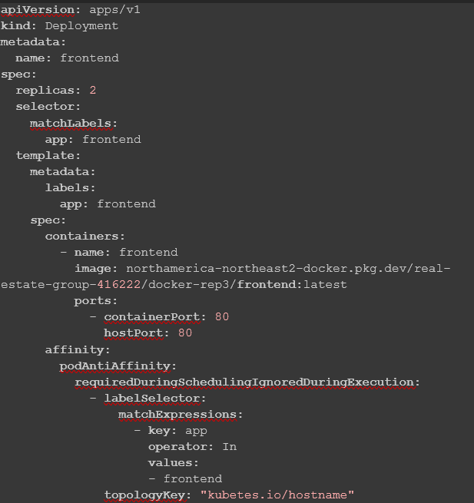
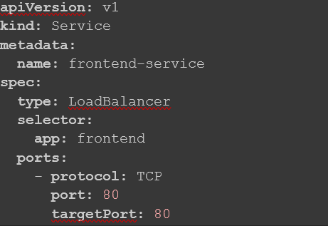
Frontend Load Balancer Manifest
Production Environment Frontend Manifest

Slide 17

Site
Production endpoint - http://34.130.53.97/
Dev endpoint – http://34.130.23.17/

Slide 18
Thank You!
question?

